Slide 1
Overview of Hive and Sqoop

Slide 2
Agenda
What is Hive
Different kinds of table supported in Hive
What is a Partition table and its beneﬁts
When to create bucketed table
Different ﬁle format supported in Hive
How to create a view in Hive
Importing data into HDFS by using Sqoop and Flume

Slide 3
What is Hive?
Hive is data warehouse tool for Hadoop
Developed by Facebook(2008)
Created to build an abstraction over the MapReduce for SQL developer
Used for structured data & require schema
Hive can not store the actual data, it stores only meta data i.e Schema of the table(MySql).
Hive is not designed for OLTP.
Can we run the hive with out MR

Slide 4
Query engines in Hive
There are 3 different query engines supported in Hive such as Tez, MapReduce and Spark
Hive queries are translated into corresponding jobs and will be run on the cluster to generate the output.
So, Hive queries have higher latency, due to the start-up overhead for running jobs.

Slide 5
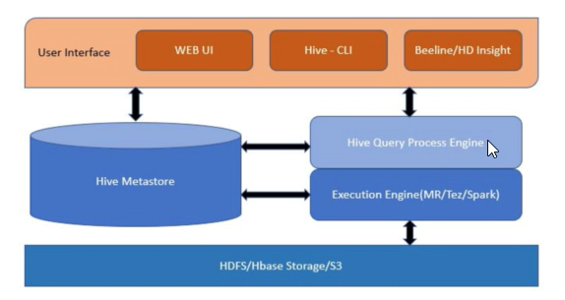
Hive Architecture

Slide 6
Hive MetaStore
Hive metastore (HMS) is a service that stores metadata related to Apache Hive and other services
Hive metastore uses RDBMS, such as MySQL or Postgres
Impala, Spark, Hive, Presto and other services share the same metastore.

Slide 7
Hive MetaStore
The HMS includes the following Hive metadata about tables that you create:
A table deﬁnition
Column names
Data types
Comments in a central schema repository
HIve
MetaData
MetaStore
D
a t
a HDFS

Slide 8
Hive Datatype
Data Type | Description
TinyInt | Range of Values
SmallInt
Int
BigInt
String | Character Sequence
Boolean | T or F
Timestamp | YYYY-MM-DD MM:HH:SS
Binary | Raw Bytes
Array | collection of similar datatype
MAP | Key-value Pairs
Struct | collection of dissimilar datatype(Record)

Slide 9
Basic HiveQL Syntax
Hive keywords or not case sensitive (Although data)
Though they are capitalized by convention
Statements are terminated by semicolon
Double hyphen used to comment the line , no multiline comment

Slide 10
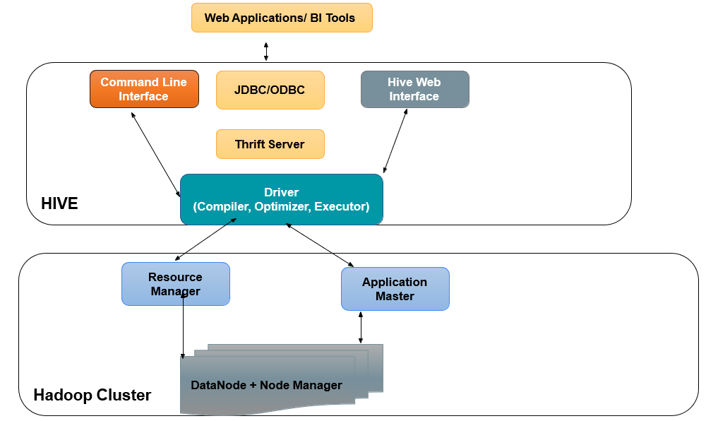
Hive Architecture
Compiler
Converts query into Logical Plan
Optimizer
Improves logical plan with more optimized technique
Executor
Executes the plan by running in Hadoop cluster

Slide 11
Partitioning?
A method to organize large datasets into smaller, manageable parts based on partition keys. (Employee city wise)
Improves query performance by scanning only relevant partitions.
Easy Maintenance of large data set
Hive table data is stored in directories.
When Partitioned, data will be stored in sub directories.

Slide 12
Types of Partitioning
Static Partitioning
Dynamic Partitioning

Slide 13
Static Partitioning
Manually control where data is stored by explicitly defining partition values during data loading.
Example: Suppose you have a sales table partitioned by year and month
CREATE TABLE sales ( id INT, amount DOUBLE, product STRING )
PARTITIONED BY (year INT, month INT);
INSERT INTO sales PARTITION (year = 2023, month = 01)SELECT id, amount, product FROM <source_table> WHERE year=2023 and month=01;
Result: Data for January 2023 is stored in a specific partition, and queries that filter by year and month will only scan the relevant partition.

Slide 14
Dynamic Partitioning
Automatically determine the partition values based on the data itself during the loading process..
Example: Same sales table as above, but data contains both year and month fields.
CREATE TABLE sales ( id INT, amount DOUBLE, product STRING )
PARTITIONED BY (year INT, month INT);
Loading Data Dynamically:
SET hive.exec.dynamic.partition = true;
SET hive.exec.dynamic.partition.mode = nonstrict;
INSERT INTO TABLE sales PARTITION (year, month) SELECT id, amount, product, year, month FROM <source table> where year=2023 and month=01
Result: Data is automatically partitioned based on the year and month values.

Slide 15
Bucketing Table
Buckets in hive is used in distributing hive table-data into multiple ﬁles
The division is performed based on Hash of bucketing columns
In Hive, we have to enable buckets by using set.hive.enforce.bucketing=true;
You can create buckets on only one column
Bucketed tables allow more efficient sampling than non-bucketed table
Bucket column should typically be one that is frequently used in join conditions or predicated in queries

Slide 16
Creating Bucketing Table
CREATE TABLE customers ( customer_id INT, customer_name STRING, city STRING ) CLUSTERED BY (customer_id) INTO 4 BUCKETS;
INSERT INTO TABLE customers VALUES (101, 'Alice', 'New York'), (102, 'Bob', 'Los Angeles'), (103, 'Charlie', 'Chicago'), (104, 'David', 'Houston'), (105, 'Eve', 'Philadelphia’);
Bucket 1: Rows where hash(customer_id) % 4 == 0
Bucket 2: Rows where hash(customer_id) % 4 == 1
Bucket 3: Rows where hash(customer_id) % 4 == 2
Bucket 4: Rows where hash(customer_id) % 4 == 3

Slide 17
Beneﬁts of Hive Bucketing Table
Optimized Hive tables and data
Enables more efﬁcient queries
Evenly distribute the data.

Slide 18
What is Tez
Alternative data processing framework to MapReduce
Who is involved?
Hortonworks, Facebook, Twitter, Yahoo, Microsoft
Why does it matter?
Widens the platform for Hadoop use cases
Crucial to improving the performance of low-latency applications
Evidence of Hortonworks leading the community in the evolution of Enterprise Hadoop

Slide 19
File formats supported in Hive
Hive supports various file formats , these file format can be categorized as
Row format
Columnar format
Row format : record is stored as row such as sequencefile, avro and json
Columnar format : record is stored as column-by-column manner such as ORC and Parquet files,

Slide 20
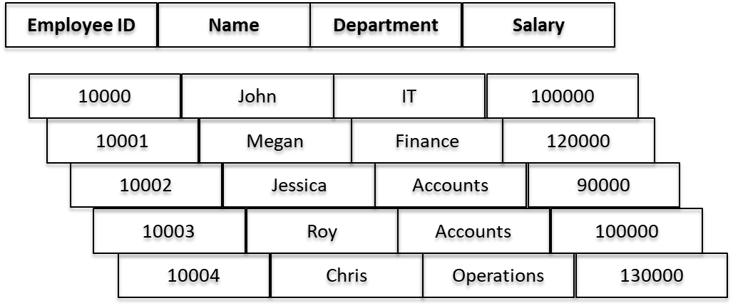
Row oriented Storage in Hive

Slide 21
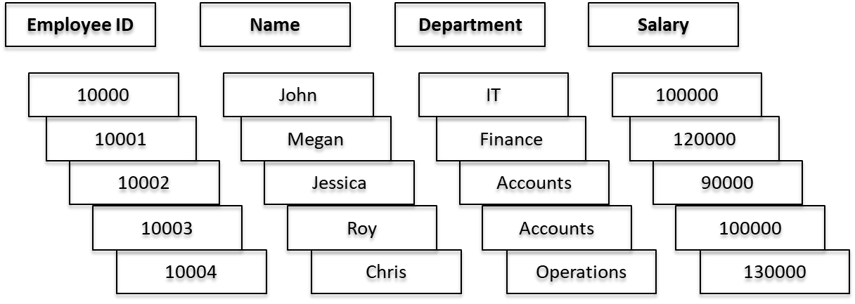
Column oriented Storage in Hive

Slide 22
Advantage of Columnar Format
Columnar storage like ORC and Parquet uses data encoding to bring more efﬁciency compared to row-based ﬁles.
When querying, columnar storage can only relevant columns from disk and skip over the non-relevant columns.
With these optimization, aggregation queries take less time and memory compared to row-oriented structures.
This kind of storage results into better disk utilization and minimized latency for accessing data.

Slide 23
HQL
Hive Query Language
SQL like scripting language developed to query and analyze data in Hadoop cluster
Create, Drop, Alter, Truncate, Describe
Load files to table
Moving data from file to Hadoop table

Slide 24
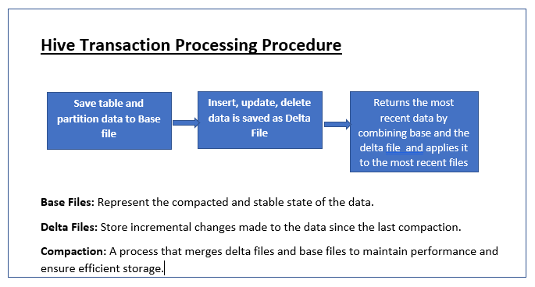
Hive Transactions
Version 0.13 (2014-15)
Available for tables in the ORC file format
ACID property

Slide 25
Transaction Support in Hive
Data for the table or partition is stored in set of base files
Updates and deletes are stored in delta files
A new set of delta files are created for each transaction that alerts the table of the transactions
At read time read merges the base file and delta file
Compactor Set of background processes running inside the Meta store to support ACID property

Slide 26
Hive Views
Views allow query to be saved and treated just like a table.
View is a logical construct and does not store data.
Used to simplify queries.
Syntax to create a View:
CREATE VIEW ViewName AS
<predicate>
SELECT
<cols> FROM
<table> WHERE
WHERE clause is optional.
A view’s name must be unique compared to all other table and view names in the same database.

Slide 27
Hive Views
Query a view just like how you query a table.
If a query references a view, the deﬁnition of the view is combined with the rest of the query by Hive’s query planner.
No storage allocated for this logical view.
However, Hive 3.0 also supports Materialized view which will save view data into a HDFS folder

Slide 28
Nested Queries and CASE Statements
hive> SELECT * FROM student_info s where s.marks > (SELECT avg(marks) FROM student_info);
Hive allows use of CASE statements to enable you to classify records depending on various inputs
SELECT name,CASE WHEN marks >= 66 THEN 'DISTINCTION', WHEN marks < 66 AND marks >= 60 THEN 'FIRST CLASS, WHEN marks < 60 AND marks >= 55 THEN 'SECOND CLASS,
WHEN marks < 55 AND marks >= 50 THEN 'THIRD CLASS, ELSE 'FAIL'
END AS class FROM student_info;

Slide 29
Limit, Like, RLike , Group By and Having
hive> SELECT * FROM student_info limit 10;
LIKE and RLIKE operators compare and match strings or substrings from a given set of records. Following is an example:
hive>SELECT * FROM student_info WHERE name LIKE 'A%'; Hive>SELECT * FROM student_info WHERE name LIKE '%Jr.%';
Similarly, RLIKE allows you to query data by putting regex hive>SELECT * FROM student_info WHERE name RLIKE '.*(Jr|Sr)*.';
hive>SELECT class, avg(marks) FROM student_info GROUP BY class; hive> SELECT class, avg(marks) FROM student _info GROUP BY class HAVING class = 'V' OR class = 'VI;

Slide 30
Built-In and User-deﬁned function(UDF)
Hive supports a variety of built-in functions, such as: Arithmetic functions, Mathematical functions and Aggregated functions
hive>SELECT avg(percentage) FROM student_info;
hive>SELECT upper(name) FROM student_info;
Sometimes, you may require to custom modify certain values in columns, and it may not be feasible to use built-in functions.
In such a case, Hive allows its users to deﬁne their own functions to be used in SELECT statements
To create a User-Deﬁned Function (UDF), you need to write a Java class that extends org.apache.hadoop.hive.ql.exec.UDF.
In that class, write the evaluate () method where you can modify the default behavior.

Slide 31
Joins : Inner and Outer Joins
hive>SELECT o.order_id, c.customer_name FROM order o RIGHT OUTER JOIN customer c ON ( o.customer_id =
c.customer_id);
hive> SELECT o.order_id, c.customer_name FROM order o LEFT OUTER JOINcustomer c ON ( o.customer_id = c.customer_id);
hive>SELECT o.order_id, c.customer_name FROM order o FULL OUTER JOIN
customer c ON ( o.customer_id = c.customer_id);

Slide 32
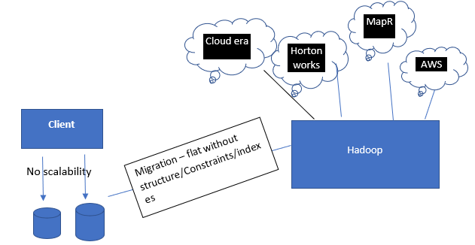
RDBMS to Hadoop Migration

Slide 33
SQOOP
Cloudera 2009
Moving data between Hadoop and RDBMS
SQOOP is a MR tool for importing data from RDBMS and Hadoop
SQOOP convert import command into Map only Job to import data
Parallel Map tasks help importing the data transfer
SQOOP uses JDBC connection of databases to run the query and fetch the data

Slide 34
SQOOP - SQL+Hadoop
Sqoop can import
RDBMS -> Hadoop
RDBMS -> Hive
RDBMS ->Hbase
Sqoop can Export
HDFS – RDBMS
Hive -> RDBMS
Hbase -> RDBMS not possible

Slide 35
Importing a Table from Mysql to Hive
We use import command to table from sql to hive
sqoop import \
--connect jdbc:mysql://hostname/dbname \
--username myusername \
--password mypassword \
--table mytable \
--hive-import \
--create-hive-table \
--hive-database myhivedb

Slide 36
Incremental Imports
Append Mode: Imports rows where a specified column has a value greater than the maximum value from the last import.
Lastmodified Mode: Imports rows where a specified timestamp column has a value greater than the last import time.
sqoop import \
--connect jdbc:mysql://hostname/dbname \
--username myusername \
--password mypassword \
--table mytable \
--incremental [append|lastmodified] \
--check-column column_name \
--last-value last_imported_value \
--target-dir /path/to/hdfs/directory

Slide 37
Scoop Now in the Market
The database connectivity capabilities of Spark make it the most flexible solution
Apache Kafka and Apache NiFi are faster alternatives
SQOOP results into MR Jobs only
Cloud specific integration tools (Azure Datafactory, AWS Redshift)

Slide 38

Apache Hive was developed by Facebook in 2007
Before hive, End users had to write map/reduce programs for simple tasks like getting raw counts or averages

Slide 39








Sqoop
Node on which is Sqoop is installed
Hadoop Cluster
Submit MapReduce Job
Map
Node 1
JDBC
Fetch Metadata
Map
Node 2
Map
Node 3
sqoop import
--connect jdbc:mysql://<Server Name>/<Database>
--username <User name>
--password <Password>
--table <Table Name>
Map
Node 4

Slide 40

Import to Hive
sqoop import --connect jdbc:mysql://localhost:3306/testing --username root
--table greatlearning_employees --hive-import --hive-table subex.mysql_employees --fetch-size 10 -m 2
Sqoop
Hive
RDBMS
HDFS

Slide 41
Import to Hive
sqoop import --connect jdbc:mysql://localhost:3306/testing --username root
--query 'select A.name,B.role from greatlearning_employees A JOIN employees_role B ON A.id= B.id where $CONDITIONS' --target-dir
/sqoop_mysql_query --fetch-size 10 -m 2 --split-by A.name
Sqoop
Hive
RDBMS
HDFS

Slide 42

Export
sqoop export --connect jdbc:mysql://localhost:3306/testing --username root
--table emp_duplicate --export-dir /sqoop_mysql_employees1 -m 2 --driver com.mysql.jdbc.Driver
Sqoop
HDFS
RDBMS

Slide 43

Let us perform some hands-on
✔ Create Hive internal and external table
✔
✔
✔
Executing Hive query using Tez engine
Executing Hive query using MR engine
Creating Partition table to store data into ORC format

Slide 44
Thank You

